Slide 1





ProbeSim: Scalable Single-Source and Top-k SimRank Computations on Dynamic Graphs
Yu Liu , Bolong Zheng, Xiaodong He, Zhewei Wei, Xiaokui Xiao, Kai Zheng, Jiaheng Lu
Notes:
1(+ next slide 0.5min).Hello everyone, it’s my pleasure to present our work. My name is Yu and I’m from Renmin University of China. This is a joint work with professor Zhewei, Xiaokui and Jiaheng. It deals with fast computation of SimRank queries on large and dynamic graphs.

Slide 2




Outline
Backgrounds
Our ProbeSim Algorithm
Experiments
Notes:
1(0min).Here’s the outline of my talk. First I’ll briefly give some backgrounds, followed by the intuitive idea of our ProbeSim algorithm; at last I’ll show some interesting experimental results.

Slide 3



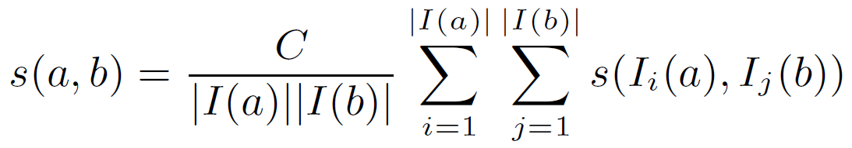
SimRank [Jeh and Widom, KDD 02]
Professor A
Student A
University
Most similar
to itself!
similar
(less) similar
Professor B
Student B
Notes:
(1 min)1.The idea of SimRank was proposed by Jeh and Widom in KDD 2002, and now has more than 1600 citations.
2.Let me use this example graph to show its basic idea. Professor A and B both come from some university, and they both have a student.
3.First every object is most similar to itself; then, the two professors are similar because they are from the same university; at last, the two students are also similar but a little less, because their advisors are similar, and the similarity decays during propagation.
4.Formally, SimRank is defined by this equation, which says the similarity of two objects is determined by the similarity of all possible pairs of their in-neighbors. Here c denotes the decay factor between 0 and 1.

Slide 4



Applications of SimRank
  Collaborative filtering [Jeh and Widom, KDD02]
  Clustering via semantic links [Yin et. al., VLDB06]
  Recommendation system [Nguyen et. al., WWW15]
Rating=3
Rating=2
0.7
0.2
Last.fm user
0.9
Rating=5
Notes:
(1min)There are lots of applications of SimRank, like collaborative filtering and recommendation systems.
For example, consider the system needs to guess the rating of a user to a given singer, to determine whether to recommend the singer to him.
First the system needs to find k most similar singers already rated by the user, by some similarity measure such as SimRank, which performs well.
Then the system computes a weighted score according to the similarity.

Slide 5
Random Walk Interpretation of SimRank
  The Random Surfer-Pairs Model [Jeh and Widom, KDD02]
  Refined by SRK-Join[Tao et.al, VLDB14] and SLING[Tian and Xiao, SIGMOD16]
Sim(u,v) = Pr[Random walks from u and v meet]
*Decay factor Ignored.
Notes:
(0.5min)1.Computing by the definition of SimRank induces huge cost on large graphs, which is equivalent to iteration of matrix multiplication. The authors of SimRank proposed another random walk interpretation.
2.It says the similarity of u and v is the probability of two random walks meet, starting from u and v respectively, following the in-edges and with same steps.
3. Several works refined this definition by considering the decay factor, making it more efficient.

Slide 6
Random Walk Interpretation of SimRank
  Example of random walk meet
u
t
s
Meet !
v
Notes:
(+next slide 1min)1. In this example, both u and v start a random walk. The walk of u is u to s then to v, and the walk of v is to t and then back to v. They meet at v.

Slide 7
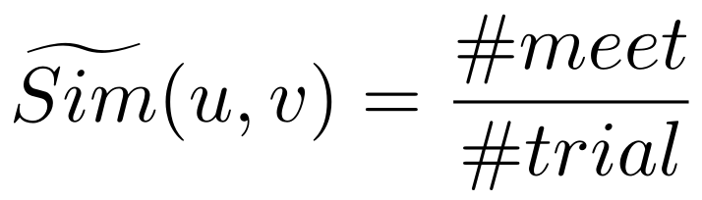
The Monte Carlo (MC) Algorithm
  Single pair query (given u, v)
Meet !
Never Meet.
u
u
…
v
v
Trial 1
Trial 2
Trial n
Notes:
1. (0.5min)Motivated by the meeting definition of SimRank, for single pair query, the MC algorithm takes n trials and count meet number. Since each trial is an unbiased estimation, by the concentration inequality, the MC estimation can be arbitrarily precise as long as there are sufficient trials.

Slide 8
The Monte Carlo (MC) Algorithm
  Single source/Top-k query (given u, query all v)
# walk pair generated = |V| * # trial
n
O(logn/ε²)
Answer size
O(|V|) for single source query,
and O(k) for top-k query!
Notes:
(1min)However, for the single source or top-k query, the cost of MC is too high. The number of walk pairs needs to be vertex size times number of trials. To guarantee the absolute error is no larger than epsilon for any vertex, the number of trials needs to be logn over square of epsilon.
On the other hand, the answer size is relatively small. For single source query, it’s no larger than vertex size, but typically much smaller because a large fraction of nodes have negligible similarity w.r.t the query vertex. For top-k query the answer size is just a constant.
Thus, there is a big gap between the performance of MC algorithm and the problem complexity.

Slide 9
State-of-the-arts for Single Source/Top-k
Method | Time | Space | Drawbacks
TopSim [Lee et.al, ICDE12] | ~O(|D|^{2t}) | - | 1. Heuristics -> No accuracy guarantee; 2. Slow on large graphs.
TSF [Shao et.al, VLDB15] | O(R_{g}R_{q}t|V|) | O(R_{g}|V|) | 1. Assumption -> No accuracy guarantee; 2. Large sized index!
SLING [Tian & Xiao, SIGMOD16] | O(|V|/ε), O(|E|log₂1/ε) | O(|V|/ε) | 1. Large index and preprocessing time; 2. Do not support dynamic graph
Notes:
There are already some improvements of MC algorithm, such as the TopSim, TSF and SLING, but they either rely on heuristics
Which make them have no accuracy guarantee and give poor results in practice;
Or need large index which limits the scalability, and do not support queries on dynamic graphs.

Slide 10
Our Approach: the ProbeSim Algorithm
…
x
w
v
u
Notes:
1.(+next slides 2min)In order to guarantee the error and query cost, We propose the ProbeSim algorithm, combining the forward random walk and backward searching strategies.
2. The algorithm also take many trials.
3.For each trial, first we sample a random walk from the query vertex, following in-edges each step.

Slide 11
Our Approach: the ProbeSim Algorithm
…
x
w
depth = 3
v
depth = 2
s
u
b
c
depth = 1
1
0
Unbiased estimator!
With probability Pr[u and b meet], Score(b) = 1;
Otherwise Score(b) = 0.
Notes:
(1.5min)For each node on the walk, we start a BFS-like traversal following out-edges.
The depth of traversal is equal to the distance of this node to query vertex.
As an example, s is an out neighbor of w, which has 3 in-edges and one comes from w. Then s randomly select one edge and see if it connects to w.
Similarly, b samples one in-edge which links to s. Then the score of b is set to 1. Since c samples some other edge, the score of c is 0.
It can be shown that with probability of u and b meet, the score of b is 1, otherwise 0.
Which is an unbiased estimator, same as the MC algorithm.

Slide 12
Intuition: ProbeSim vs MC
Never meet
Meet here
…
…
…
…
…
u
..
…
……
Query vertex
Very similar
Similar
Less similar
Not similar
Notes:
1.We show the benefits of ProbeSim in improving query efficiency. Given a query vertex, only a few nodes are similar, and most nodes have similarity = 0.
2.For MC, every node need to sample many walks. For nodes are very similar, the walks meet at short distances, for less similar nodes the meeting distance are larger.
3.For non-similar nodes, the walks never meet in a fixed step. These walks are wasted.

Slide 13
Intuition: ProbeSim vs MC
…
Unreachable!
u
..
…
……
Query vertex
Very similar
Similar
Less similar
Not similar
Notes:
1. The random probing procedure of ProbeSim guarantees that practically, only a small fraction of similar nodes have non-zero scores. Most nodes are not reached, thus significantly improves the practical efficiency.

Slide 14
Some Optimization Techniques…
  Probe deterministically when cost is low
  Many trials -> Batch up random walks!
  Pruning rules
Notes:
(+next slides 1min)There are also some optimization techniques to speed up query and improve accuracy.

Slide 15
Some Optimization Techniques…
  Probe deterministically when cost is low
x
w
<- cost is low, compute
deterministically
v
s
Score(s) = 1/3
<- high cost, probe
randomly
u
b₁
b_{n}
Score(b₁) = 1/3
Score(b_{n}) = 0
Notes:
1.For example, if we find computing the score has low cost, we compute it directly. In this example, the score of s is 1/3 instead of 1, which has smaller variance. Since the next step has many edged involved, we still use random probe. If b1 is selected, the score of b1 is score(s).
2.We also formally prove that with all these optimizations, our algorithm has probably approximately correct guarantee.
2.For more details, please refer to our paper.

Slide 16
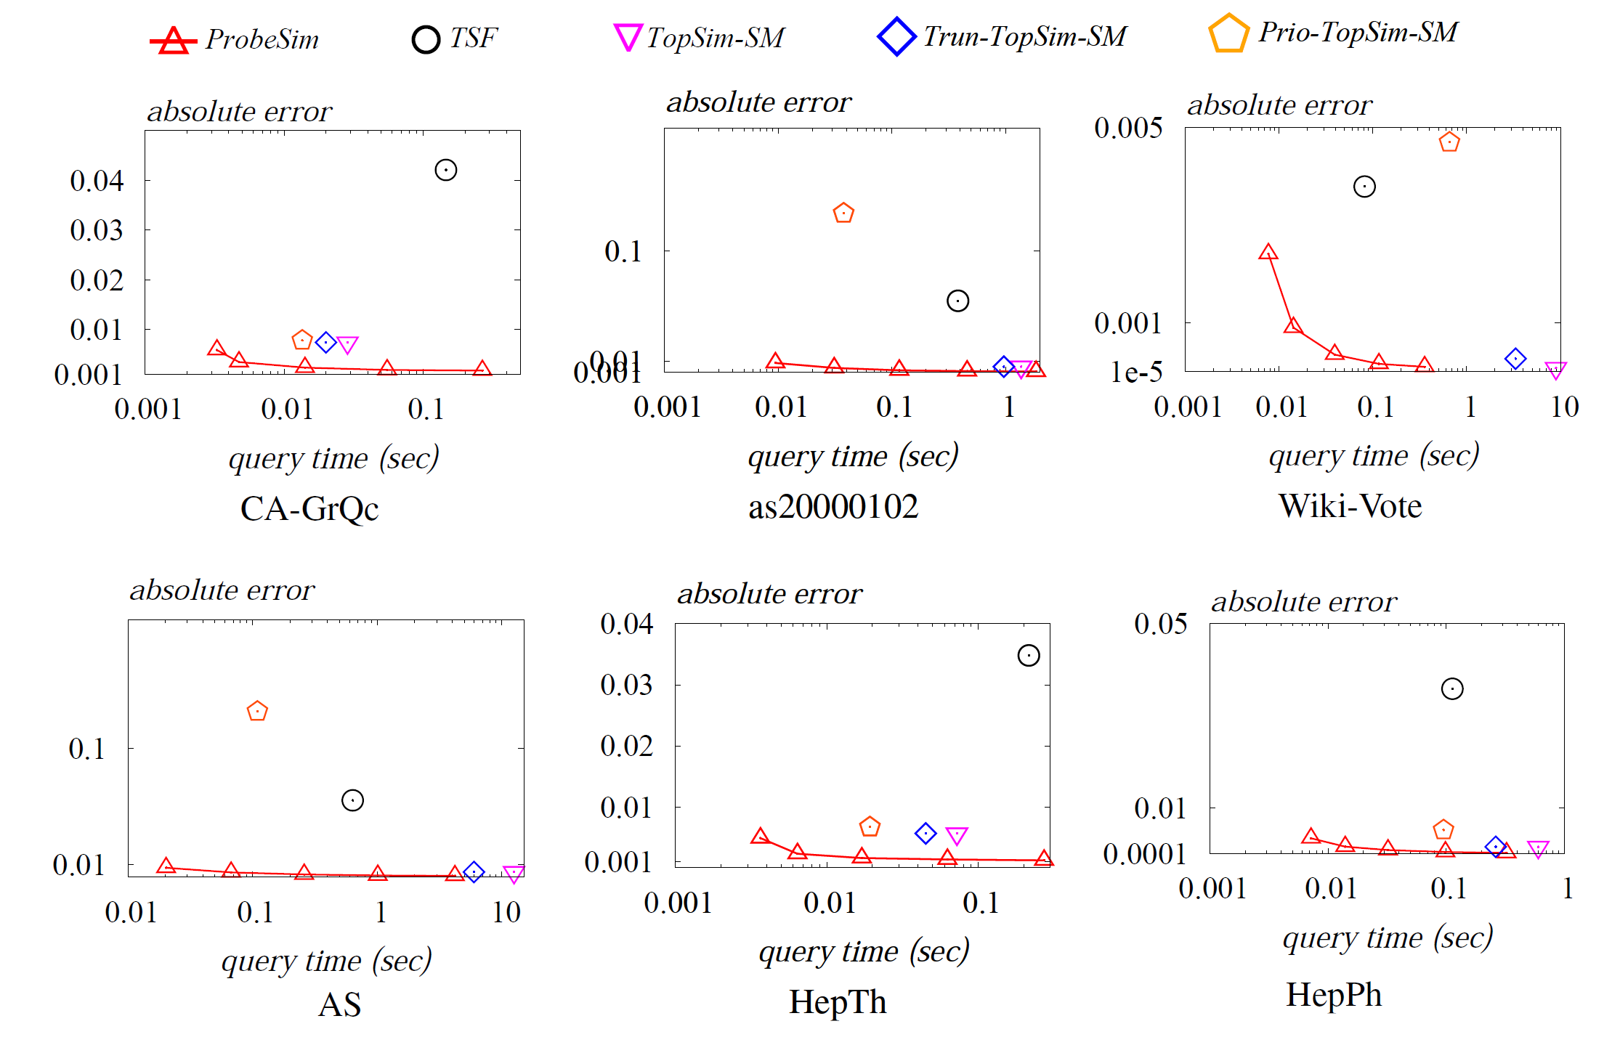
Experimental Results: Small Datasets
Absolute error
Notes:
(+next slide 0.5min)In the following I’ll show some interesting experimental results. We first conduct queries on small graphs, and compare ProbeSim with TSF and TopSim, with all their optimizations. They are the state-of-the-arts on dynamic graphs.
For absolute error, our algorithm varies the error guarantee. ProbeSim consistently outperforms other algorithms.

Slide 17
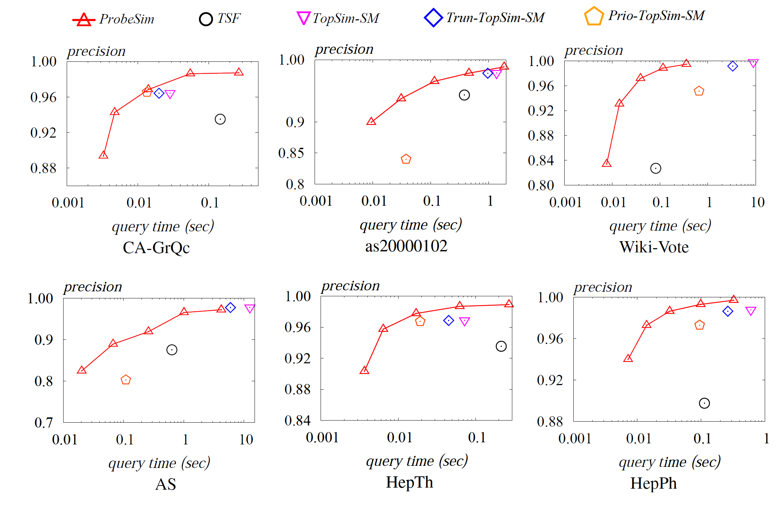
Experimental Results: Small Datasets
Precision@k (k = 50)
Notes:
For top-k queries, ProbeSim achieves higher precision using same time.
Furthermore, ProbeSim is more flexible in the tradeoff between efficiency and effectiveness.

Slide 18

Experiments: Large Datasets
Large Datasets
Graph | U/D | n | m
LiveJournal | Directed | 4,847,571 | 68,993,773
it-2004 | Directed | 41,291,594 | 1,150,725,436
twitter-2010 | Directed | 41,652,230 | 1,468,365,182
friendster | Undirected | 68,349,466 | 2,586,147,869
Cost too high!
Top-k answer
Ground truth unavailable!
Use the idea of pooling!
Result 1
…
Result n
Notes:
1.(0.5min)We further consider the evaluation of algorithms on 4 large graphs, where the largest contains billion edges.
2.Previous works do not consider such graphs since computing the ground truth incurs too high cost.
3.We use the idea of pooling, which comes from information retrieval. Briefly it says once we have n results, to find top-k, we give n results to some expert and let him evaluate the answer.

Slide 19
Pooling: An Example
6
4
1
2
3
5
7
Query vertex: 3
k=3
Notes:
1(+ next 3 slides, 0.5min). I’ll use this example to illustrate the idea of pooling. Assume the query vertex is 3 and we want to know the top-3 similar nodes (except itself).

Slide 20
Pooling: An Example
ProbeSim
6
1
5
4
4
1
2
3
5
7
Query vertex: 3
k=3
Notes:
1. ProbeSim gives 1,5,and 4.

Slide 21
Pooling: An Example
6
4
1
2
TopSim
3
1
2
4
5
7
Query vertex: 3
k=3
Notes:
1.TopSim computes 1,2 and 4.

Slide 22
Pooling: An Example
6
4
1
2
3
5
7
Query vertex: 3
TSF
k=3
2
7
4
Notes:
1.The answer of TSF is 2, 7 and 4.

Slide 23
Pooling: An Example
ProbeSim
Use MC algorithm for pooling !
6
1
5
4
4
1
2
TopSim
1
2
4
v | s(3, v)
1
2
4
5
7
3
5
7
Query vertex: 3
TSF
k=3
2
7
4
Notes:
1.(0.5min)We merge the answers of 3 algorithms and use MC algorithm for pooling.
2.The number of candidates is no larger than 3 times k, which can be efficiently evaluated.

Slide 24
Pooling: An Example
ProbeSim
Use MC algorithm for pooling !
6
1
5
4
Precision = 2/3
4
1
2
TopSim
1
2
4
v | s(3, v)
1 | 0.353
5 | 0.249
7 | 0.235
4 | 0.196
2 | 0.171
3
Precision = 1/3
5
7
Ground truth:
1, 5, 6
Query vertex: 3
TSF
k=3
2
7
4
Precision = 1/3
Notes:
(0.5min)We take the top-3 among the candidates, assuming this is the ground truth, and do the evaluation.
Note that we do not know the exact ground truth, in this example is 1,5 and 6. Because no algorithm finds 6.
But it’s sufficient to evaluate the relative performance of algorithms.

Slide 25
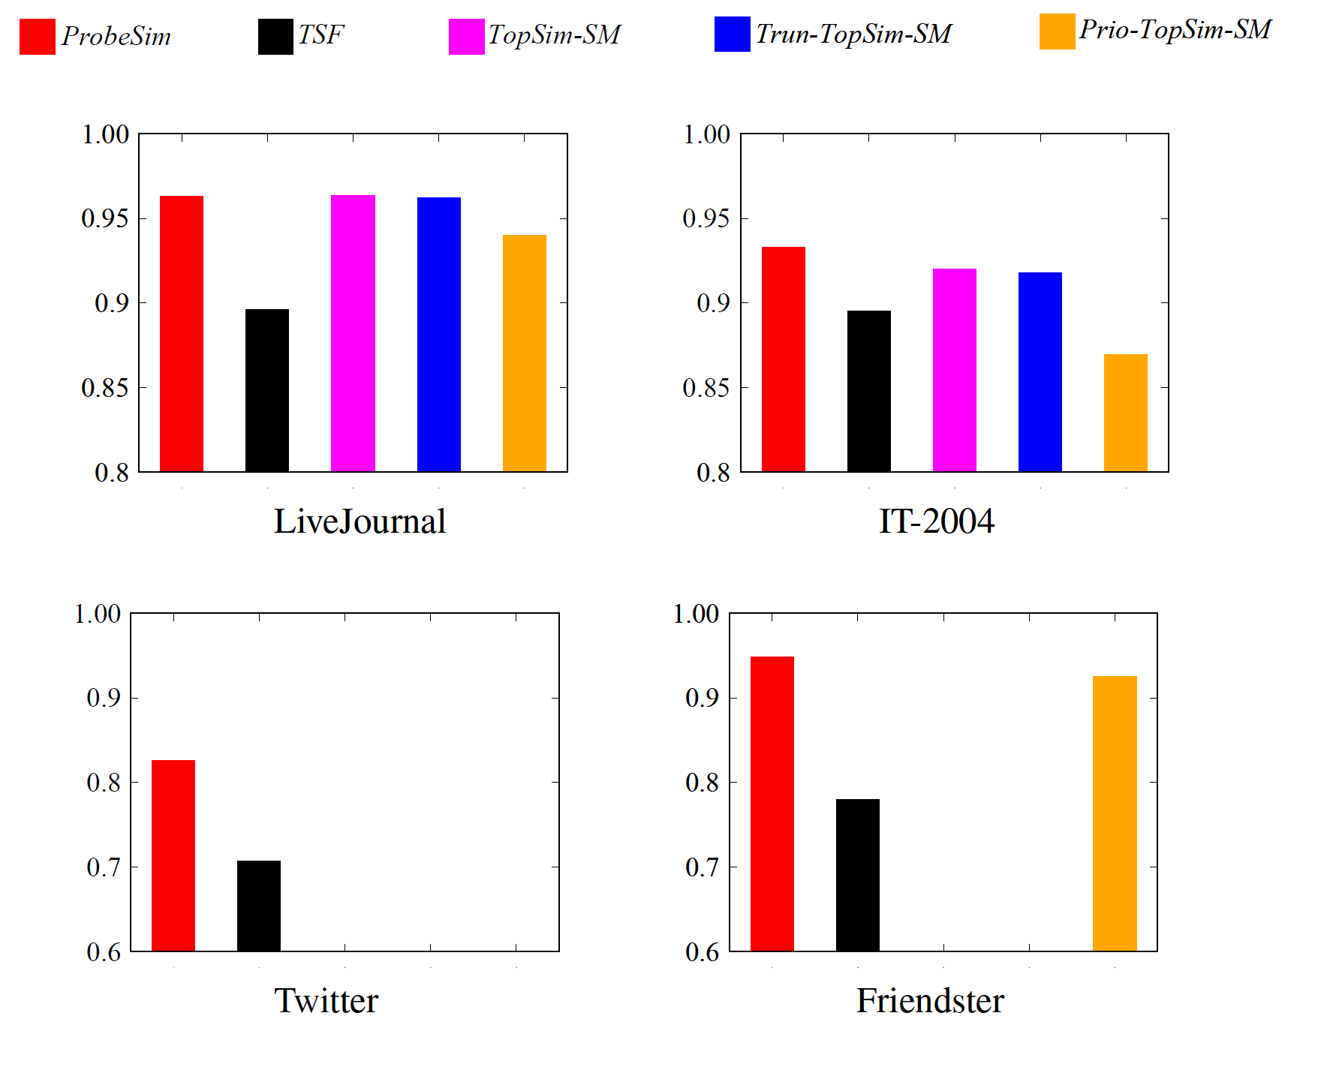
Experimental Results on Large Graphs
Precision@k (k = 50)
Notes:
1.(+next slide 0.5min)We use the above method to compare the precision of different algorithms.
2.For precision, on LJ, ProbeSim is as good as TopSim, on other datasets ProbeSim is consistently better for a significant margin.

Slide 26
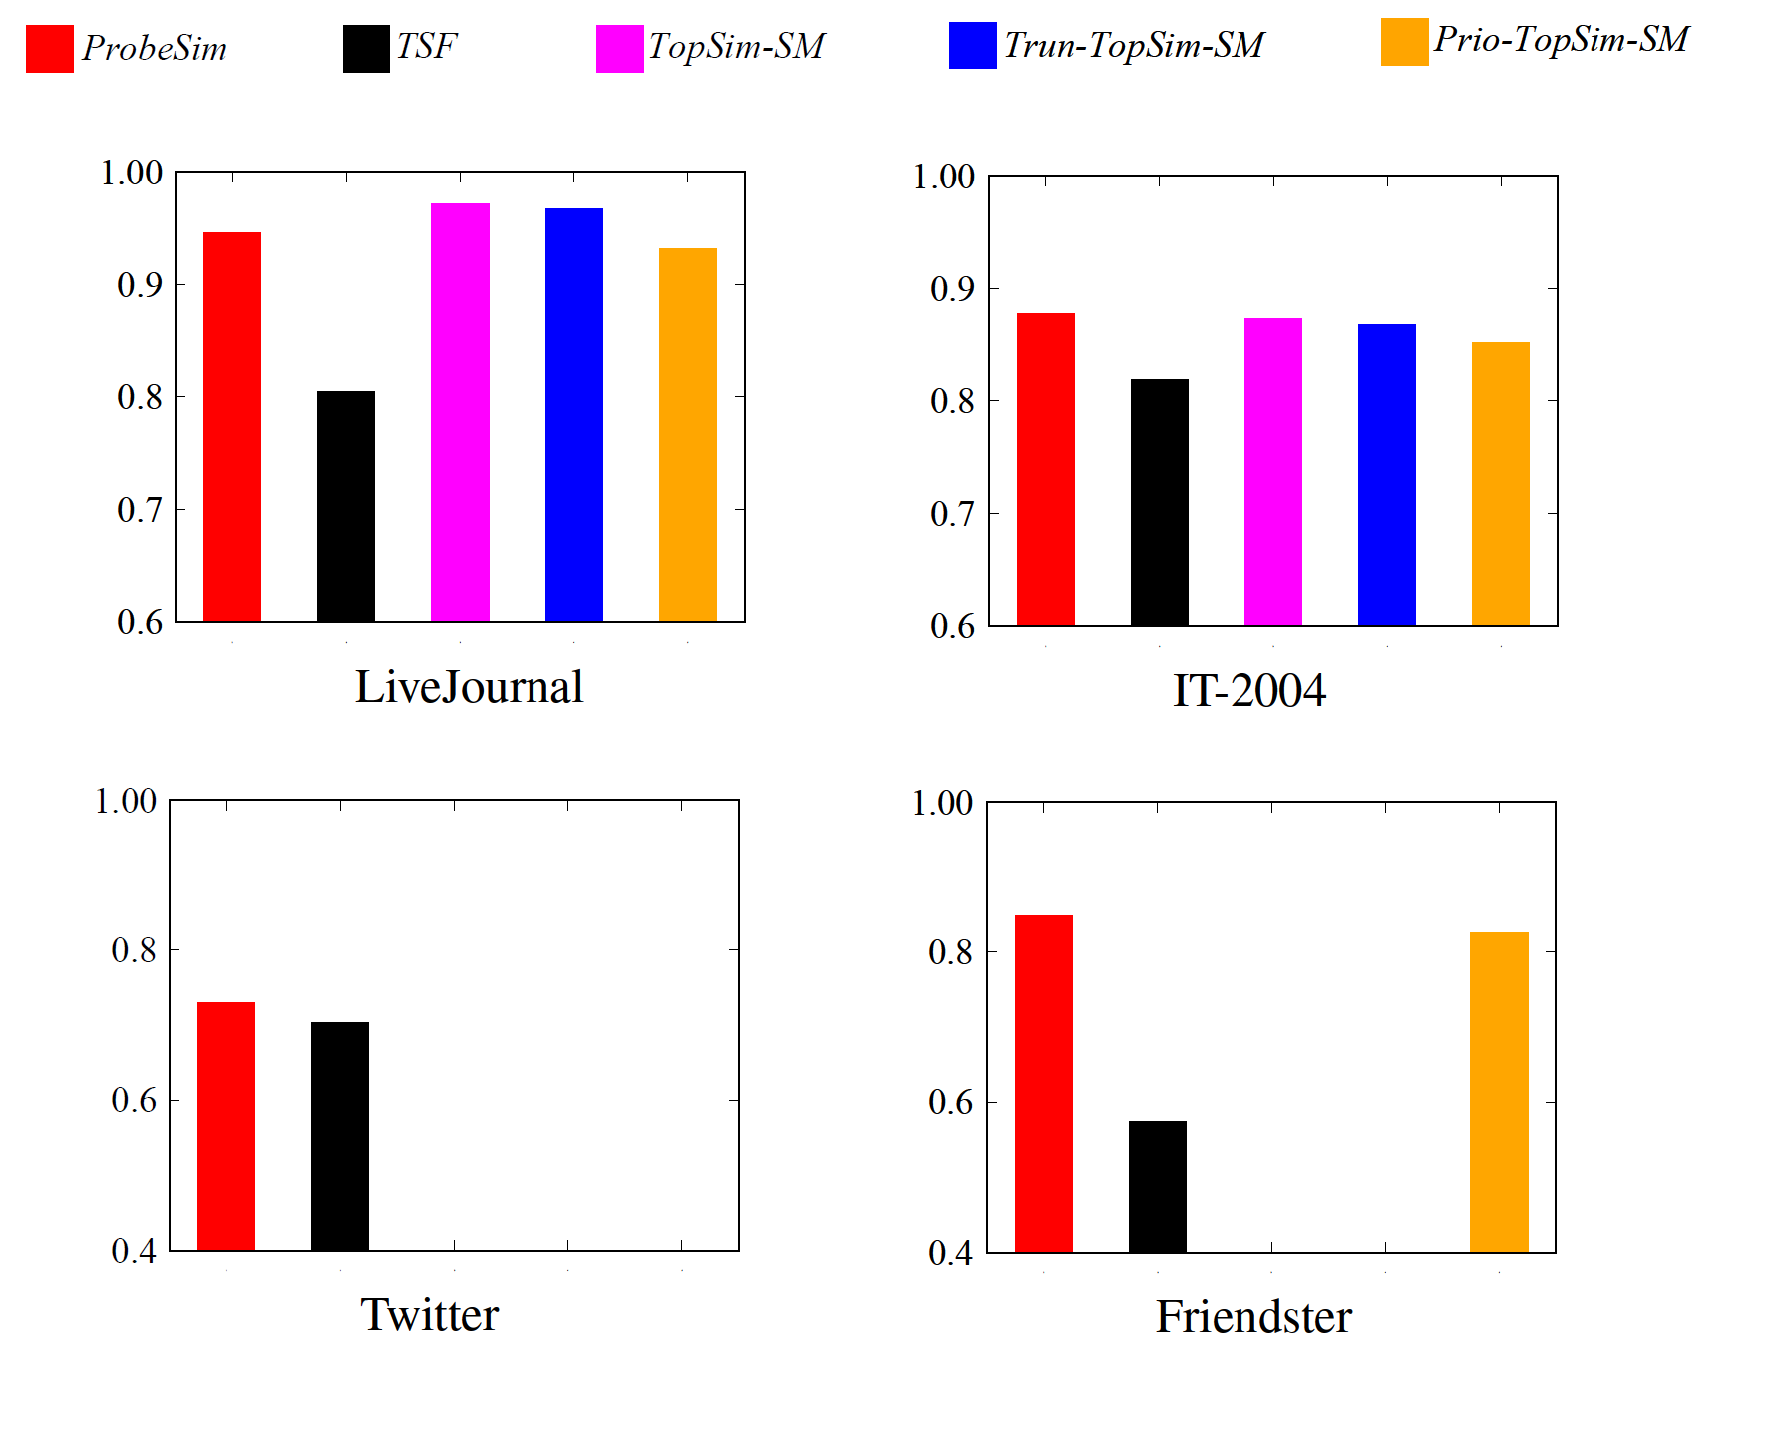
Experimental Results on Large Graphs
Tau@k (k = 50)
Notes:
1.We also evaluate Tau, which measures the correctness of ranking.
2.The result is similar as Precision. We’ll show later that by taking more time, ProbeSim can be better than TopSim on LJ.

Slide 27
Experimental Results on Large Graphs
Query Time (Sec)
Dataset | ProbeSim | TSF | TopSim-SM | Trun-TopSim | Prio-TopSim
LiveJournal | 0.056 | 0.48 | 439.82 | 6.2 | 0.6
it-2004 | 0.018 | 1.01 | 35.18 | 0.67 | 0.2
twitter-2010 | 13.6 | 191.28 | N/A | N/A | N/A
friendster | 0.93 | 1036 | N/A | N/A | 65.08
Notes:
(0.5min)This slide shows the query time of different algorithm, using same parameters as previous slide.
ProbeSim is much faster than other algs. For example, it’s 3 to 4 orders of magnitude faster than TopSim on LJ, and give similar results.
TSF and TopSim is hard to handle billion scale graphs such as twitter and friendster, because of excessive query time or index out of memory.

Slide 28
Experimental Results on Large Graphs
Query Time (Sec)
Dataset | ProbeSim | TSF | TopSim-SM | Trun-TopSim | Prio-TopSim
LiveJournal | 0.056 | 0.48 | 439.82 | 6.2 | 0.6
it-2004 | 0.018 | 1.01 | 35.18 | 0.67 | 0.2
twitter-2010 | 13.6 | 191.28 | N/A | N/A | N/A
friendster | 0.93 | 1036 | N/A | N/A | 65.08
Memory Cost (GB)
Dataset | Size (GB) | ProbeSim | TSF | TopSim-SM | Trun-TopSim | Prio-TopSim
LiveJournal | 0.88 | 0.05 | 10.8 | 17.2 | 10.1 | 0.09
it-2004 | 10.9 | 0.4 | 83.7 | 1.7 | 0.9 | 1.0
twitter-2010 | 14.3 | 0.6 | 79.1 | N/A | N/A | N/A
friendster | 23.4 | 0.9 | 99.2 | N/A | N/A | 1.9
Notes:
1.(0.5min)We show the memory cost of these algs. ProbeSim has memory cost much smaller than graph size, which is consistent to its property of locality.
2.TSF needs to construct and store index in memory, which costs most.
3.TopSim still cost more memory than ProbeSim due to the traversal strategy, and fails on largest graphs.

Slide 29
Conclusions
First single source and top-k SimRank algorithm for dynamic graphs of billion scale, and with theoretical accuracy guarantee
Outperforms existing methods in query efficiency, accuracy and scalability
First evaluation on large graphs by pooling
Our code available at https://github.com/dokirabbithole/ProbeSim_vldb_pub
Notes:
1.(1min)To conclude our work,
we (read…)

Slide 30
Thank you!
Q & A
Notes:
Thank you. Any question?

